Slide 1
Mapping Coronavirus pandamic on world’s map using python
Syed A. Bukhari, PhD
National research council of Canada

Slide 2
Motivation
The world is facing one of the biggest challenges of 21st century because of COVID-19 pandemic. The motivation behind this work is to use data analytics techniques to visualize the spread of the virus around the world. A visualization on a map can be easily understood by a someone who does not have a good background to work with complex analytical techniques.

Slide 3
Outline
The topic
The data
Results &Visualization
Summary and future directions

Slide 4
The topic: Mapping COVID 19 Why?
Hot topic for researchers and data scientists
Numerous free data available updated daily
Chances to learn statistical testing, regression, AI, ML and mathematical modeling in single topic
Important because the pandemic is not over yet
Up to date online help availabe

Slide 5
The data
The data was downloaded as xlsx file from
https://ourworldindata.org/coronavirus
Data file imported to pandas data-frame
Data contained other useful information as age, sex, medical condition number of people effected.
The data was availabe in json, csv and xlsx formats

Slide 6
Results and data visualization

Slide 7
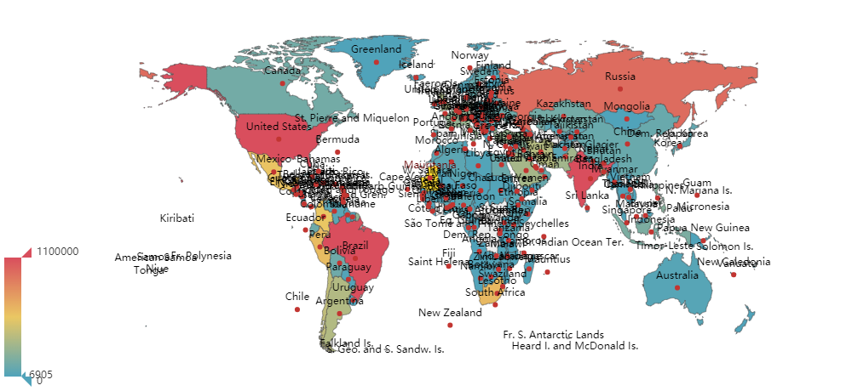
Country wise data on world’s map
Fig. 1: Interactive map showing country wise covid-19 data as of Aug 25, 2020. It looks messy so as many country names overlapping in the map

Slide 8
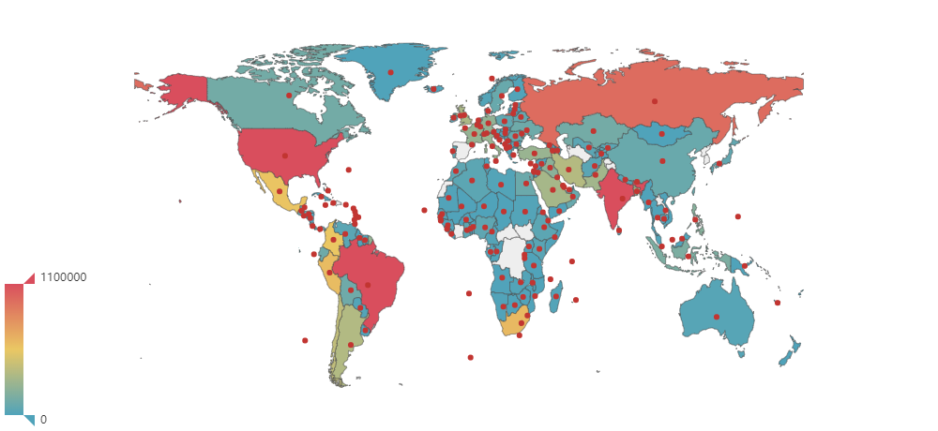
Each country labeled with a dot
Fig.2: A dot was introduced instead of countries name to get rid of the mess

Slide 9
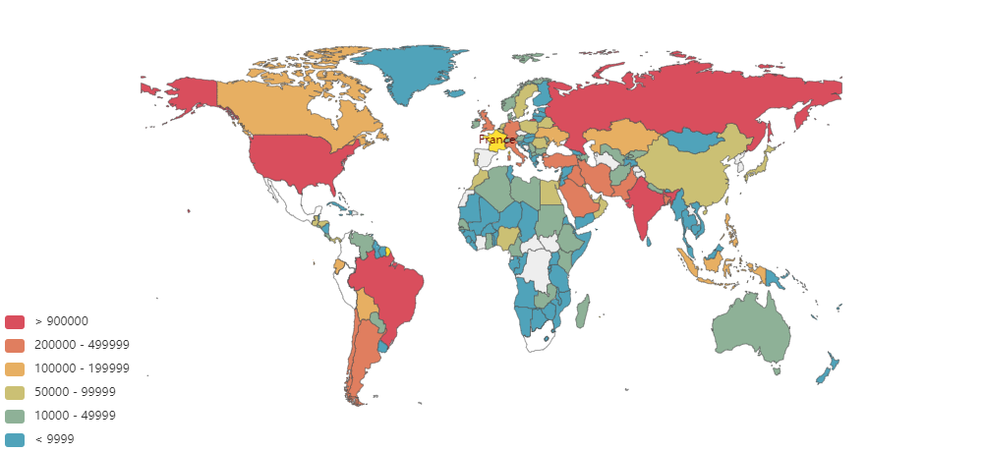
Colored map based on number of cases
Fig.3: Data is organized using conditional statement by color coding different countries having cases in certain range

Slide 10
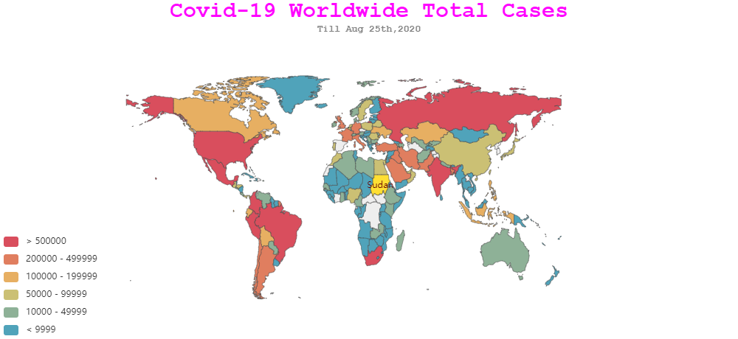
The plot title with data as of Aug 25, 2020
Fig.3: Legends are added to the map to make it more user friendly

Slide 11
Summary & future work
A very simple python program with one library was used to plot interactive map of Covid-19 data
We know the importance of understanding the spread of Covid-19
In future, I would try to develop predictive modeling by using the machine learning techniques I learned in this course

